Slide 1

Project: TA Report
IE04 Weekly Progress Report, week 4
2023/10/25
Team: Pikachu

Slide 2
Activities of Previous Week
Task | Member | Status | Work Hours
UI definition | Youssef | 100% | 1:00
User case diagram description | Merci | 100% | 0:30
PowerPoint | Merci | 100% | 1:00
 |  | Total time: | 2:30

Slide 3
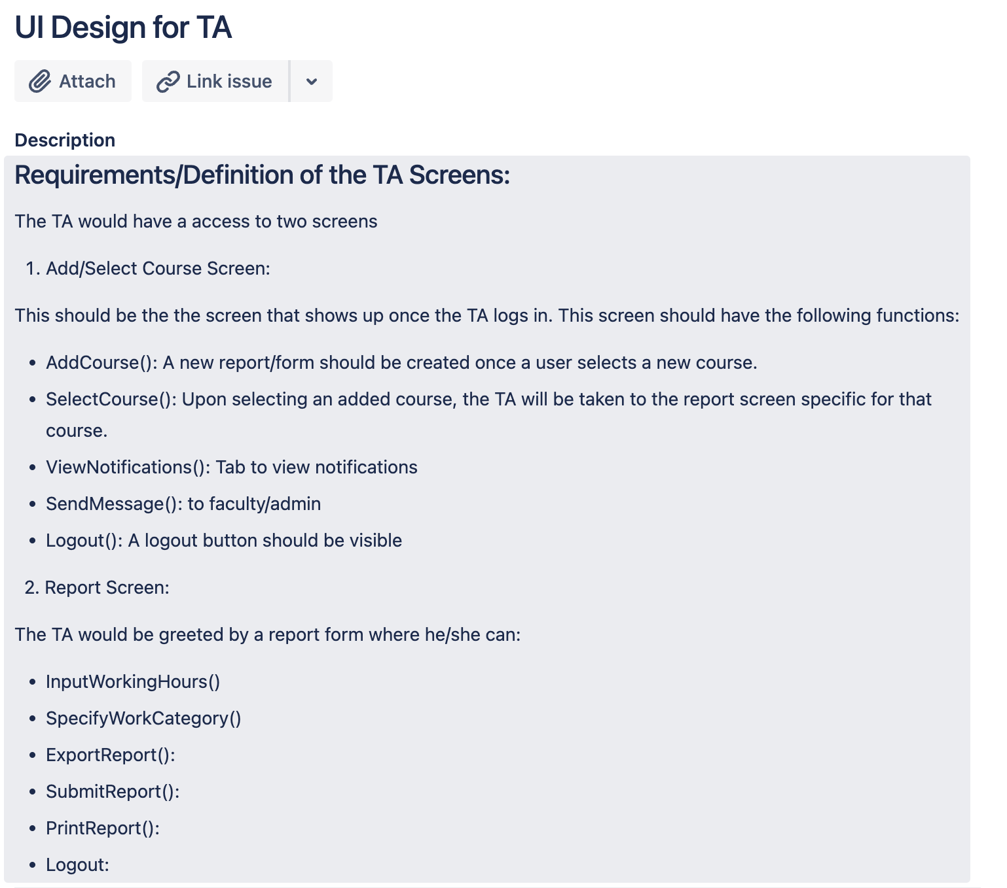
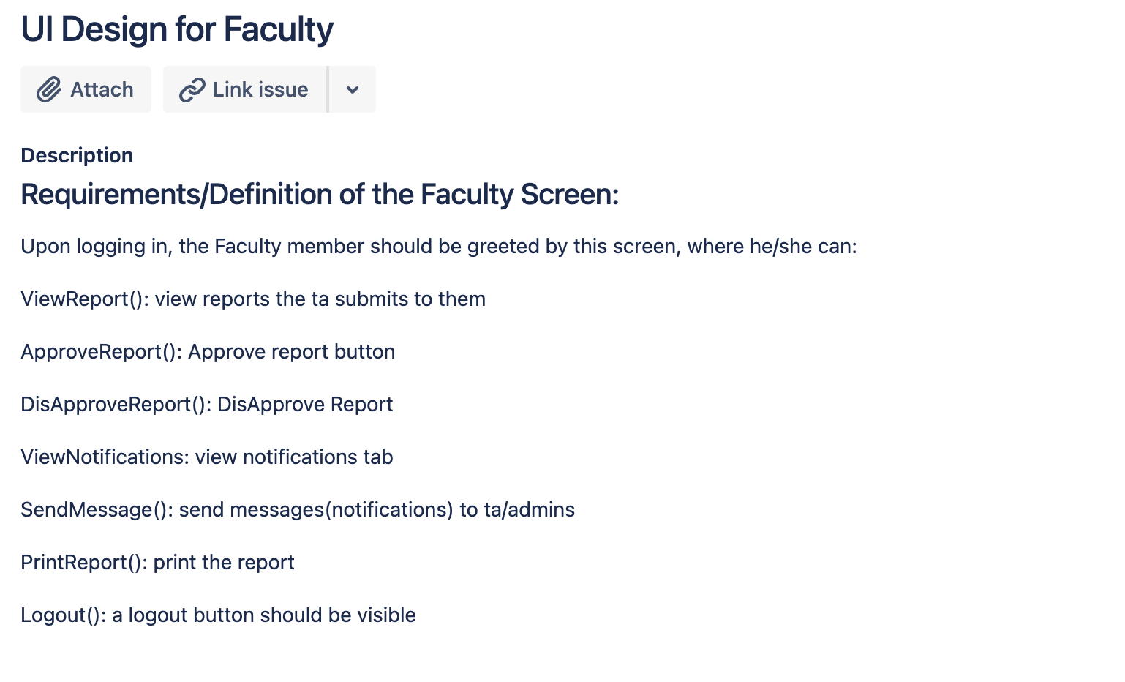
UI Definition

Slide 4
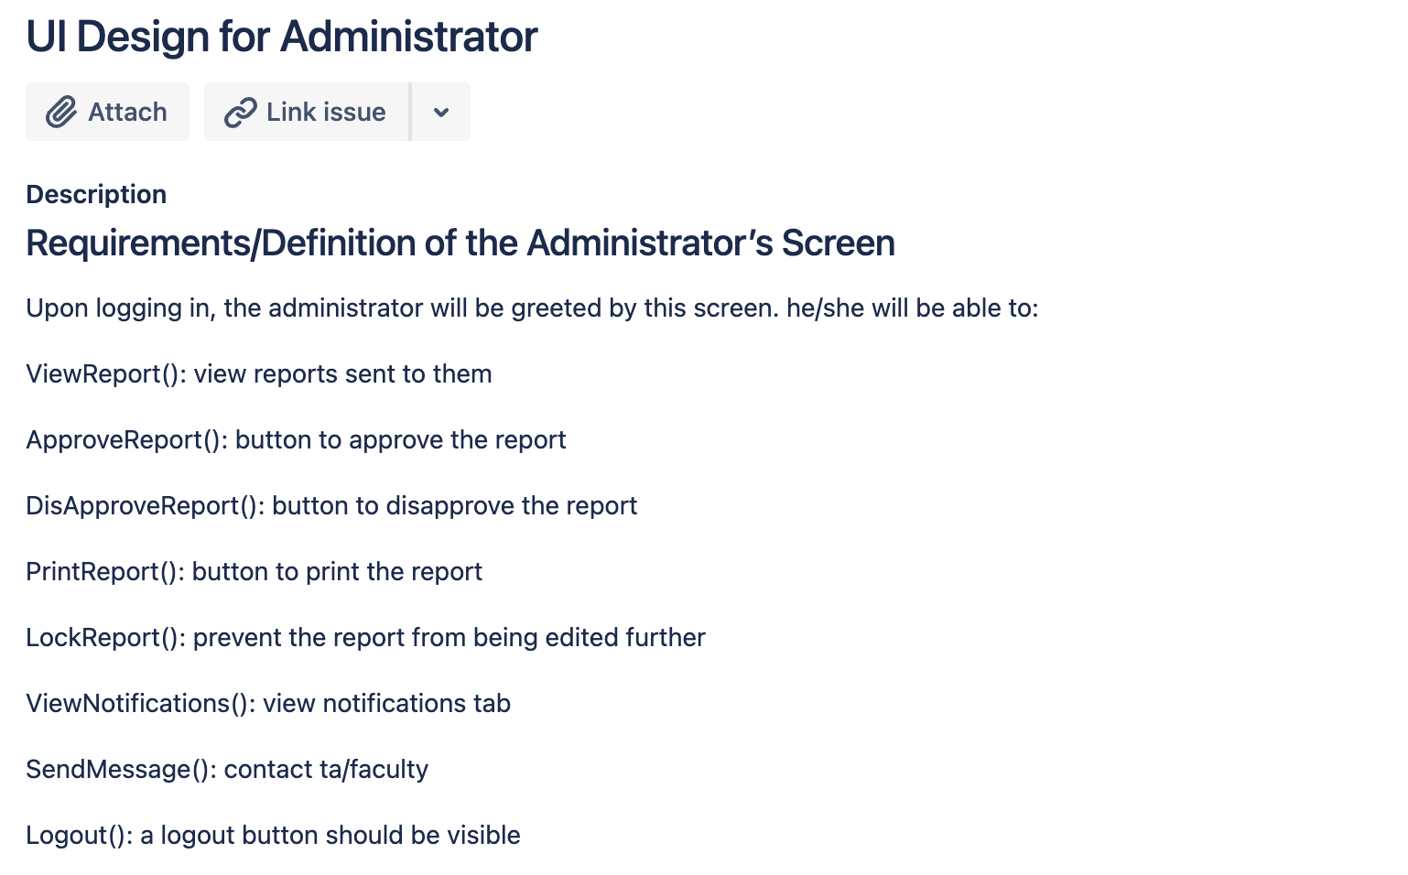
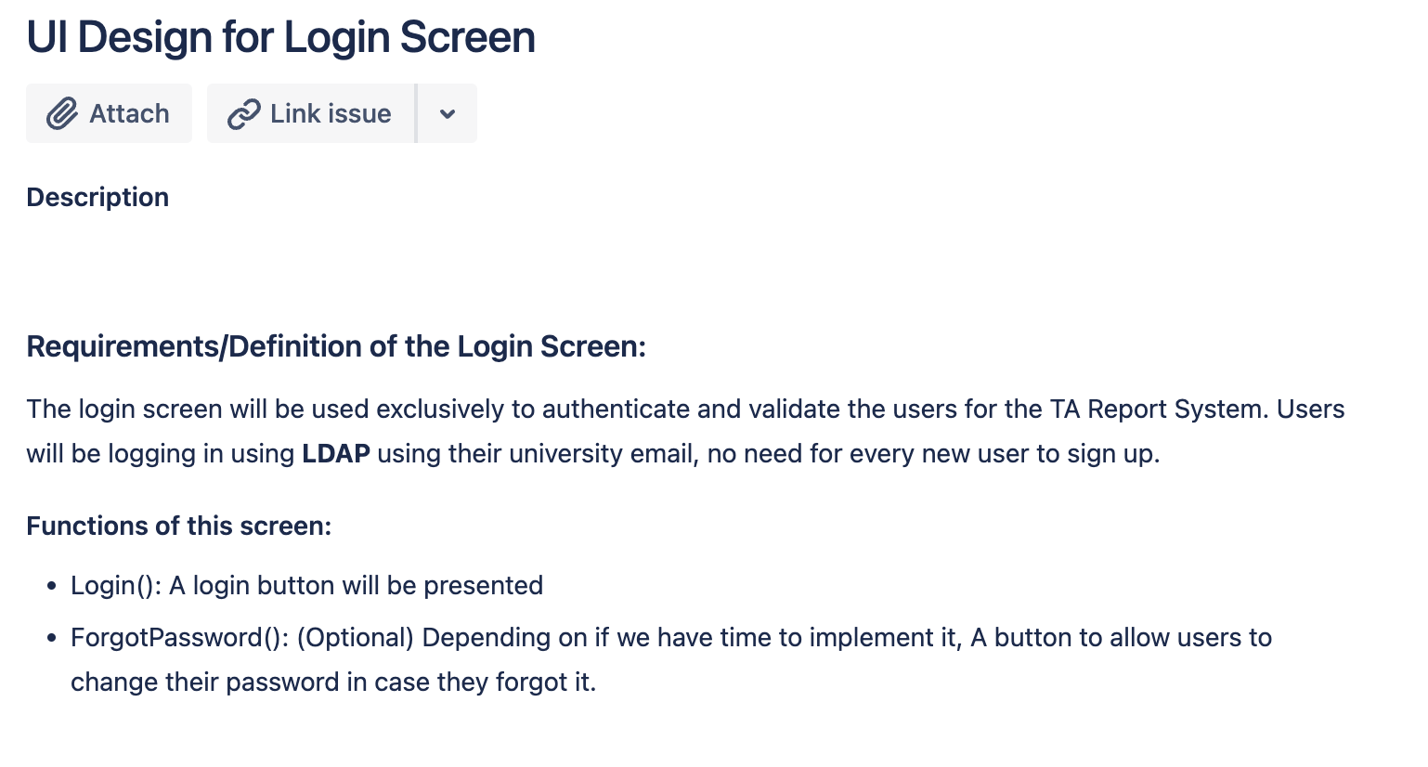

Slide 5
Use-case Diagram Description
Github
Use-Case Diagram
TA: starts the system Faculty: reviews the report SAD: approves the report
How It Works
The TA will log into the system and add/select the course
The report for that particular course will be created automatically
The TA will be able to submit the report to the faculty
The Faculty will review and either give feedback or verify the report
If the report is verified, the TA will be able to submit to the SAD
The SAD will approve the report or provide feedback

Slide 6
Plan for Next Week
Task | Member | Work Hours
Sequence diagram | Youssef | 0:30
(UI design) login screen | Youssef | 0:30
(UI design) TA course screen | Merci | 0:30
(UI design) TA report screen | Merci | 0:30
(UI design) Faculty screen | Youssef | 0:30
(UI design) Administration screen | Youssef
(UI design) Notification Tab | Merci & Youssef | 0:30
 | Total time: | 4:00

Slide 7
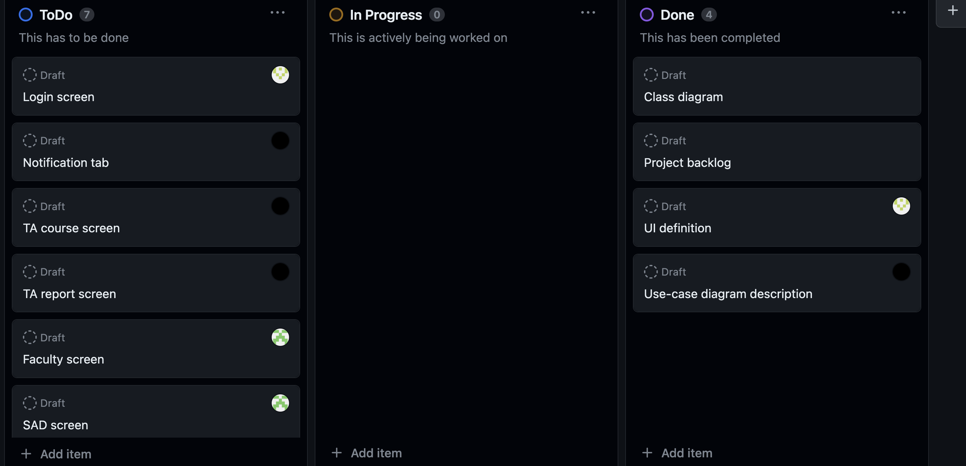
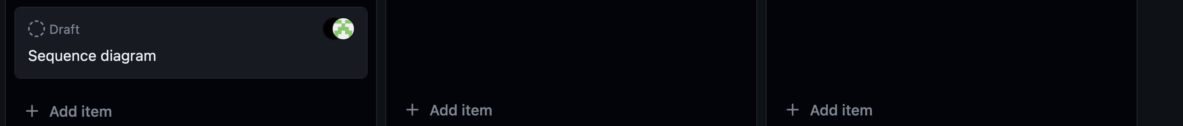
Phase Task Board

Slide 8
Issues & Risks (*if any)
Problem
Cause
Possible Solution
Deadline
Issues: Analyze what is hindering your progress. It is an existing problem that is causing delays.
Risks: Try to plan for possible problems that could cause delays.
This should help you analyze your current progress and prepare for future problems

